Slide 1

Advanced x86: BIOS and System Management Mode Internals Flash Descriptor
Xeno Kovah && Corey Kallenberg
LegbaCore, LLC

Slide 2
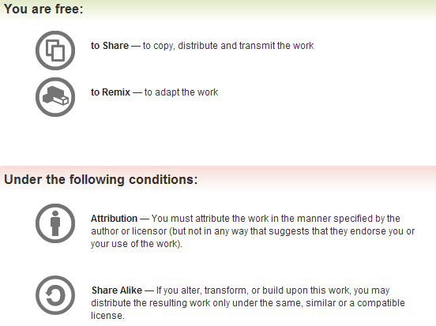
All materials are licensed under a Creative Commons “Share Alike” license.
http://creativecommons.org/licenses/by-sa/3.0/
Attribution condition: You must indicate that derivative work
"Is derived from John Butterworth & Xeno Kovah’s ’Advanced Intel x86: BIOS and SMM’ class posted at http://opensecuritytraining.info/IntroBIOS.html”
Notes:
Attribution condition: You must indicate that derivative work
"Is derived from John Butterworth & Xeno Kovah’s ’Advanced Intel x86: BIOS and SMM’ class posted at http://opensecuritytraining.info/IntroBIOS.html”

Slide 3
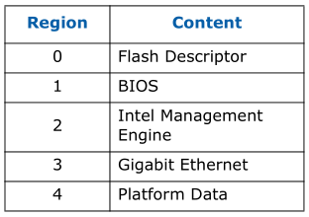
SPI Regions
Required
Required
Added in ICH9
Intel has left room for additional regions
The only ones required are the Flash Descriptor region and the BIOS region
They are not listed in the order in which they will appear on the flash chip:
Flash Descriptor will always be first, as listed, but BIOS will always be last so it ends at 4 GB of memory address space
Notes:
*** I think platform data was added for ICH9? ICH8 had only 4 regions I think.

Slide 4
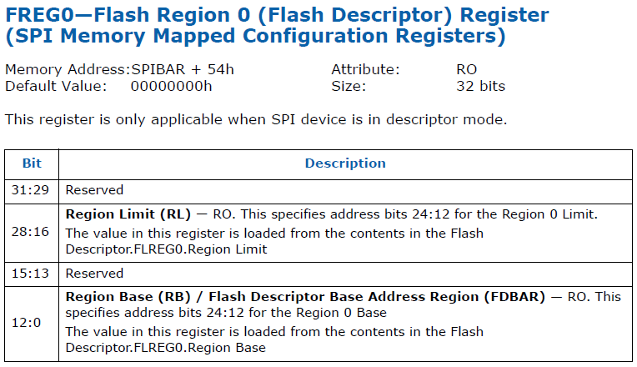

Determining SPI Regions
You can determine the regions on your flash by reading the FREG(n) registers in the SPI Base Address Registers (SPIBAR + {54 to 64h})
FREG0 to FREG4, each 32 bits
If the Base is higher than the limit, the region is unused
Notes:
*** I think platform data was added for ICH9? ICH8 had only 4 regions I think.
Note: I wanted to do a "Fred + Greg = FREG!" picture, but there's literally no famous gregs! Just enter "Greg" into google images and see for yourself!

Slide 5
Flash Descriptor
Defines most (but not all) of the flash protection that are supported by the Controller Hub
Not defined in flash descriptor:
BIOS Range Write Protection
SMI# Global Write protection (described elsewhere)
Logically OR’d together, if either are set then access is blocked
Must be written during the manufacturing process and set to Read-Only when it leaves the manufacturer, per Intel
Sometimes (rarely) the Flash Descriptor itself is left open and thus vulnerable

Slide 6
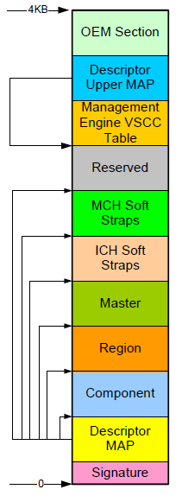
This "Flash Descriptor" structure is what's read by the ICH/PCH in order to populate and expose the information via RO registers (like FREG0) in SPIBAR
Signature 0FF0A55Ah denotes the device has a valid descriptor and is therefore operating in Descriptor mode.
Signature offset is located at 0 on ICH8, ICH9, and ICH10
In PCH it has been moved to 0x10 and bytes 0 thru 0x0F are Reserved
Pictured: ICH 10 Flash Descriptor

Slide 7
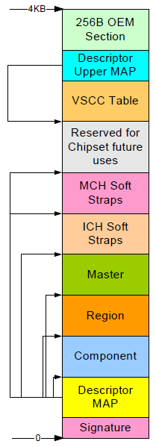
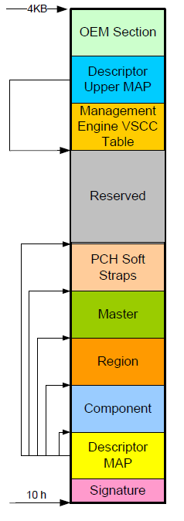
Evolution of the Flash Descriptor from ICH to PCH
ICH8
ICH9, ICH10
PCH
Still 256 bits
Still 256 bits
Renamed
Combined…
Offset shifted
ICH 8, 9, 10 are identical
Notes:
Maybe put this in the Appendix for reference and keep just the PCH one here in actual SPI section

Slide 8
The registers of the Flash Descriptor used to be documented fully in the I/O Controller Hub datasheets.
In the Platform Controller Hub datasheets, however, the Descriptor offsets and registers are no longer described.
For this reason, we will use the image of the flash descriptor as taken from ICH10.
FDBAR
ICH10 used as example

Slide 9
When describing the protection mechanisms provided by the flash descriptor, I’ll point out how they differ between ICH revisions where applicable
Remember, this isn’t an exercise in memorization but in acquiring new awareness and understanding, with that you can fill in details as they change in the future.
The functionality described will be present, even if the offsets change in the future.
Note: FDBAR is *not* a memory base address register. When you see later references to offsets from FDBAR, you’re dealing in flash linear address offsets (so you need to be careful because FDBAR will differ depending on whether you’re running an ICH (0) or PCH (0x10))
FDBAR
ICH10 used as example

Slide 10
Signature
Signature 0FF0A55Ah identifies a valid flash descriptor
A valid flash descriptor indicates the SPI flash is operating in Descriptor mode
PCH and Management Engine each require a valid flash descriptor
Located at FDBAR + 0000h
FDBAR defined in bits 12:0 in FREG0 (located in SPIBAR)
Signature offset is located at 0 on ICH8, ICH9, and ICH10
In PCH it has been moved to 0x10 and bytes 0 thru 0x0F are Reserved
FDBAR
Notes:
FDBAR = food bar = http://www.grocery.com/wp-content/uploads/2013/05/organic-food-bar-active-greens.jpg

Slide 11
Descriptor Map
Describes the data structure of the Flash Descriptor
number of sections in the descriptor
pointers to these sections as well as the size of each section
# of physical SPI flash chips present
…
FLMAP1
FLMAP0
FDBAR

Slide 12
Region
Identifies the different regions of the SPI Flash (BIOS, Mgt Eng, etc.)
Not to be confused with defining the flash descriptor map.
Each FLREG register (0-4) has a base and a limit, each corresponding to the range of that particular region
FLREG0 = Flash Descriptor
FLREG1 = BIOS
FLREG2 = ME
FLREG3 = GbE
FLREG4 = Platform Data
Disabled/unused regions will have a base of 1FFFh and a limit of 0000h
Can determine what regions are active
If BIOS region is inactive, then the BIOS is located on the FWH

Slide 13
Keeping it straight
FLREG0-4 are what's in the Flash Descriptor. The data from the Descriptor is then exposed through FREG0-4 registers.

Slide 14
Master
Defines the Read/Write capabilities that each Flash Master has with respect to each of the SPI regions, including the flash descriptor
Each SPI Master has a register that defines these permissions called the Flash Master register
Permissions apply only to register access
Notes:
ASDF

Slide 15
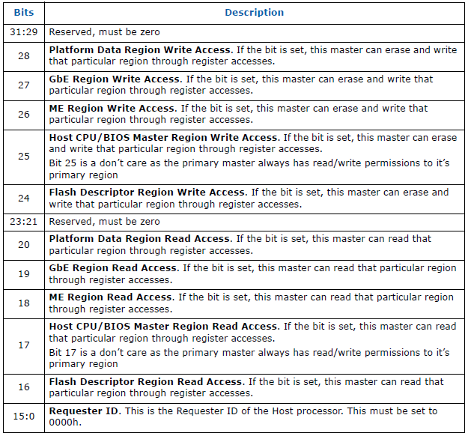
Flash Master Permissions
Register layout is identical for each of the three masters
Register location and layout is also identical across ICH8, ICH9, ICH10
Appears to be identical on PCH as well*
Should never be set anywhere!
*Based on John’s analysis of SPI serial flash dumps
Notes:
FD region needs to be made write-protected from ALL masters during manufacturing. Never supposed to change.

Slide 16
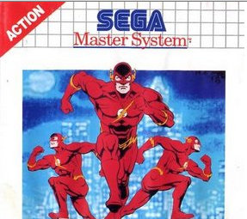
Flash Master Permissions
The requestor ID of the master attempting to access a region must match that of the defined requestor ID
2-Byte value
CPU and ME must have requestor ID’s of 0h
GbE must have a requestor ID of 0218h
Each master will always have Read/Write permission to its own region
CPU/BIOS will always be able to read the BIOS region of the SPI flash, and so on.
This is by default and hardcoded by Intel
BIOS
GbE
ME
Notes:
http://img4.wikia.nocookie.net/__cb20110829153234/marvel_dc/images/4/48/Flash_Sega_Master_System.jpg

Slide 17
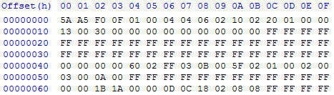
Example: FLMSTR meanings
FLMAP1 (7:0)
defines Master
section location
at 60h
Master Section
Based on analysis of the Descriptor Map (FLMAP offset 8h), we have identified that the Master section begins at offset 60h of the Serial Flash (06h is left-shifted 4 bits).
FLMAP = 12100206h (bits 7:0 define Flash Master location)
FLMSTR1 (CPU/BIOS) = 1A1B0000h
FLMSTR2 (Mgt Engine) = 0C0D0000h
FLMSTR3 (GbE) = 08080218h
*HxD doesn’t let you view the words in 32- bit format (with little-endian interpretation)
Notes:
Create a tool that analyzes a dumped binary, rather than reading from the chip. SPI programming should be handled in the advanced course.
Pop quiz: what Controller Hub family is this dump from?

Slide 18
FLMSTR1 (CPU/BIOS)
Master Section
FLMSTR1 (CPU/BIOS) = 1A1B0000h
Therefore CPU/BIOS has the following privileges:
Write (bits 28:24)
Can write to the Platform Data region of SPI Flash
Can write to the BIOS region of SPI Flash
Can write to the GbE region of SPI Flash
Read (bits 20:16)
Can read the Flash Descriptor of SPI flash
Can read the BIOS region of SPI flash
Can read the GbE region of SPI flash
*Note: The FLMAP0 register defines 03h + 1 SPI regions, therefore there is no Platform Data region on this SPI flash.

Slide 19
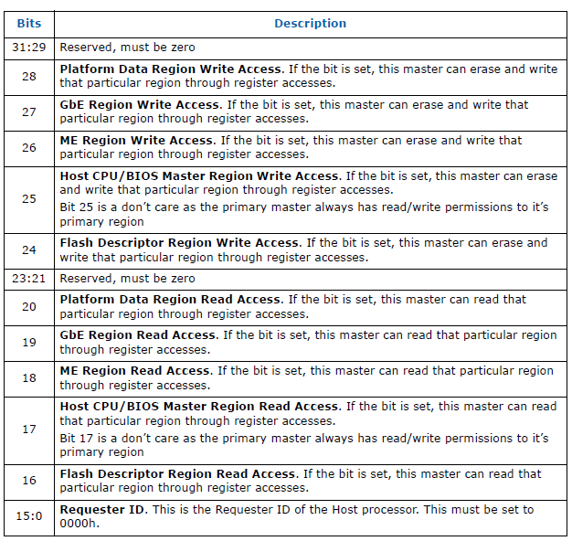
CPU/BIOS Permissions = 1A1B0000h
1
1
1
A
0
1
0
1
1
1
0
B
1
1
0000
*Note: The FLMAP0 register defines 03h + 1 SPI regions, therefore there is no Platform Data region on this SPI flash.
Notes:
Just an alternate slide format to the one prior.
I think I like the prior one better. Not sure.

Slide 20
ME Permissions = 0C0D0000h
0
0
1
C
1
0
0
0
0
1
1
D
0
1
0000
*Note: The FLMAP0 register defines 03h + 1 SPI regions, therefore there is no Platform Data region on this SPI flash.

Slide 21
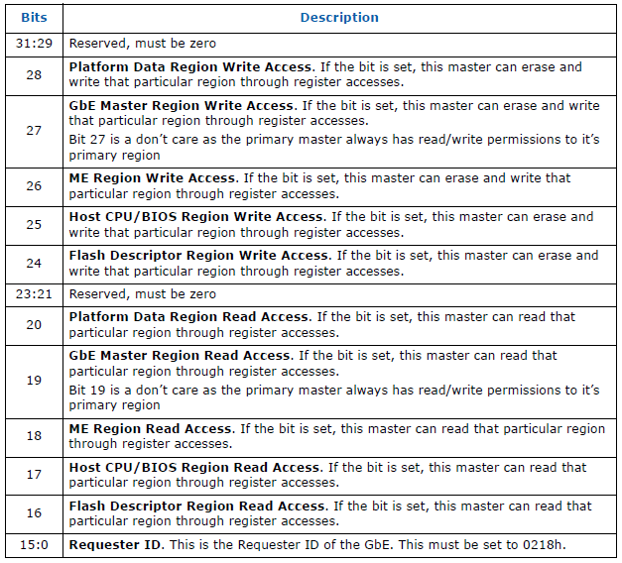
GbE Permissions = 08080218h
0
0
1
8
0
0
0
0
0
1
8
0
0
0
0218
*Note: Requestor ID 0218h is required on ICH8, ICH9, and ICH10 systems, in PCH this is 0118h
Notes:
Just an alternate slide format to the one prior.
I think I like the prior one better. Not sure.

Slide 22
Backup
Deferred due to lack of time/importance for our purposes
Included for completeness

Slide 23
Component
Identifies the different flash chips themselves and their capabilities
Read/Write/Erase clock frequencies
Even if there are 2 SPI chips, there is still just a single component section
The component section contains the Flash Invalid Instructions Register which says which instructions will be blocked from execution by the hardware

Slide 24
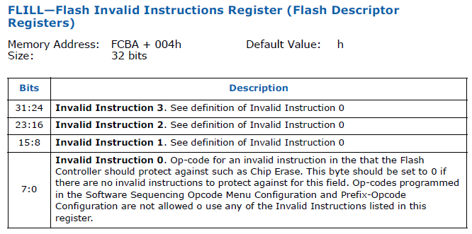


Yo
Defines opcodes that will be prevented from running on the chip by the flash controller hardware
Chip Erase (opcode 0xC7 is a good one to block)
FLILL register is constant across ICH8, ICH9, ICH10 and appears to be the same on PCH*
Same location (FCBA + 004h), same bit meanings
*Based purely on my analysis of BIOS dumps on machines running PCH

Slide 25
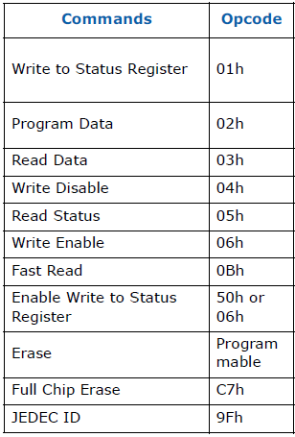
Note on SPI Instructions (opcodes)
Each ICH/PCH datasheet defines a minimal set of SPI commands that a chip must support
H/W Sequencing
Interoperability with Intel platform
This table can serve a reference to identify any opcodes that are listed in the FLILL register
However, each serial flash device may have unique capabilities and commands
ICH 10 Required Opcodes
*Write Enable looks interesting doesn’t it? A future Advanced course goes into SPI Programming

Slide 26
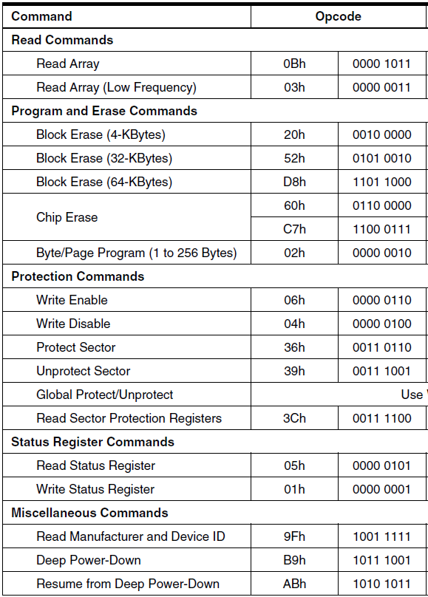
Supported opcodes on an Atmel AT25DF321A SPI Serial Flash
Taken straight from Atmel’s datasheet
Supports more than the minimum set required by Intel
Notice it supports more than one Chip Erase command
FLILL register must be filled out with these opcodes in mind, not just those that Intel lists
http://www.atmel.com/Images/doc3633.pdf

Slide 27
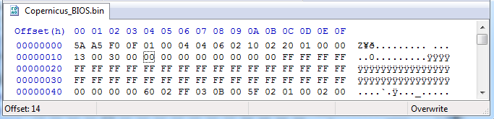
FLILL = 00000000h
Looking at the Flash Invalid Instructions Register from the Copernicus BIOS dump, we can see that none are defined
Although only 4 opcodes can be black-listed here, it’s still a setting that should be used
And the SPI Flash vendor’s datasheet should be taken into account when defining forbidden opcodes
I don’t recall any other source that has provided this recommendation

Slide 28
Soft Straps
First implemented in ICH8
In PCH, both regions are combined into a single PCH Soft Straps section
Soft Strap data is read out of the SPI device prior to de-asserting a reset (power-on, in layman’s terms)
Configure specific functions within the chipset before the BIOS or any other software can intervene
The specific details regarding the implementation of Soft Straps are located in Intel’s confidential SPI programming guides
Notes:
The soft strap data is read prior to the de-assertion of reset to both the Mgt. Engine and the host system.
Systems exit sleep mode and such via a de-assertion of a reset (different types, SLP_SUS# for instance).

Slide 29
OEM Section and Descriptor Upper MAP
OEM Section
*CH does not read the OEM information
256 bytes (ICH8, ICH9, ICH10, and PCH (up thru 8-series PCH¹)
Descriptor Upper MAP
Describes the Base and length of the Management Vendor Specific Component Capabilities (VSCC) Table
Base address is at FDBAR + EFCh (ICH8, ICH9, ICH10, and PCH²)
Recall FDBAR is offset 10h on the flash chip on PCH, 0h on all others
¹ Most recent PCH at the time of this writing
FDBAR
² Based on my analysis of BIOS binaries

Slide 30
Management Engine VSCC* Table
Contains the JEDEC ID of the Flash Chip
Identifies the Vendor and Device ID of the SPI serial flash
Describes the different attributes an SPI partition can have (Upper or Lower)
Based on the value defined in the FPBA flash descriptor register in the Master section
If SPI is defined as having one single partition, then only the attributes defined for the Upper partition are used.
*VSCC = Vendor Specific Component Capabilities

